Slide 1

Bloom Where You Are Planted

Slide 2

Providence Baptist Church Christian Education Presents:
Bloom: Prayer, discovery, application

Slide 3

Why We’re Here Today

Slide 4

Overall Aim
Close the gap
Target audience
Enhance what we do
Share the word

Slide 5
Concern
Many believers are unaware of their spiritual gift that the Holy Spirit has imparted.
Some tend to gravitate to the most seen or most common ministries.
Some may know their talent, and are working in them, but could benefit from enhancing them
Some know what to do, but need to make the connection with others to assist in the ministry.
Because we live in an ever-changing world, some may have innovative or new ideas that may need a kick-start to address our current needs.

Slide 6
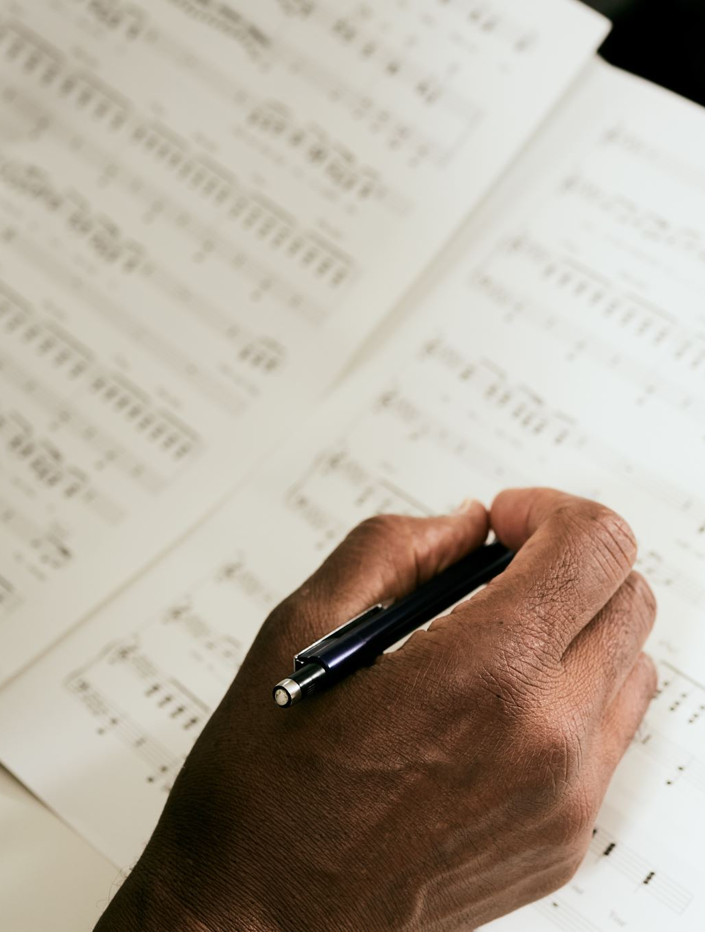
Session Goals
Prayer and Scripture
Emphasize the importance of a regular prayer life
Provide related scripture that support the body of Christ using talents in and outside of church.
Review/Discovery
Provide tools for assessment:
Website, surveys and etc. to help explore talents..
Practical Application
Engagment opportunity: Provide a hard card, link, QR code that encourages people to sign up for use of talents.
Provide an internal email address for review and contact by leadership head.

Slide 7
Prayer
Thank you, God for providing us with power gifts for service, ministry and harvest. Thank you that even though we are learning, you have already provided and will make clear to us your individual gifts to each of us. Please give us the gifts that you know we need and that will glorify You. We invite the Holy Spirit to be our Teacher as we proceed. In Jesus’ name, Amen.
What should I do about my relationship with God and the Holy Spirit? PRAY
Pray that the Spirit will teach you
Research the Bible about the Spirit
Abandon what is contrary to the Bible
Yield to what the Bible teaches

Slide 8
Food for Thought
We confess Jesus as Lord and believe that God the Father is Sovereign, but who is the Holy Spirit?
Are we willing to allow him to lead. This may be challenging for us so we tend to:
Take control back for ourselves.
Divert control to leaders, abdicating personal responsibility.
Neglect to study the Bible about what we don’t understand.

Slide 9
Holy Spirit? Who is He?
Gen 1:26 “Let us make man is our image”— A part of the Trinity—Godhead. Present before the creation of the world.
Gen 1:2 He moves over the waters before creation began.
Gen 2:7-He, the breath of God, breathed life into us.
Job 33:4 and John 6:34 confirm that it is the Spirit who gives life.
The Holy Spirit is living and active.
Jesus said the Holy Spirit would be our Comforter, Teacher, and Helper (John 14:16, 26; 16:7).
Jesus describes Him as the Spirit of Truth (John 15:26).
He has power to govern our flesh-(Galatians 5:14–18).
He is powerful-Acts 1:8 Jesus said that we would receive power when the Holy Spirit comes on us. Same word used for power is used for dynamite (Dunamis)-Miraculous, violent force. Not just a feeling, but a force.
Has powerful/transforming fruit/manifestations: Galatians 5:22-23
Agent of being born again and dwells in us at salvation: John 3:5-10
Helper (Paraclete)-John 14:26; John 15:26
Guide us to Truth-John 16:13-15
Provides knowledge of our God “…Behold, I will pour out My Spirit on you; I will make My words known to you.” Proverbs 1:23

Slide 10
Holy Spirit, cont’d.
• He teaches us all things. • He reminds us of what Jesus said. • He testifies about Jesus. • He guides us into all truth. • He glorifies Jesus. • He speaks what He hears from God. • He discloses to us what is to come.
“For to us God revealed [what He has for us] through the Spirit; for the Spirit searches all things, even the depths of God. 11 For who among men knows the thoughts of a man except the spirit of the man, which is in him? Even so the thoughts of God no one knows except the Spirit of God. 12 Now we have received, not the spirit of the world, but the Spirit who is from God, that we might know the things freely given to us by God, 13 which things we also speak, not in words taught by human wisdom, but in those taught by the Spirit, combining spiritual thoughts with spiritual words. 14 But a natural man does not accept the things of the Spirit of God; for they are foolishness to him, and he cannot understand them, because they are spiritually appraised.” 1 Corinthians 2:10–14
• He reveals what God has for us. • He searches the depths of God. • He knows and tells us God’s thoughts. • He tells us what God freely gives to us. • He teaches us to speak spiritual words. • He helps us to spiritually discern Him.

Slide 11
How do we get to know Him better? Moving from spectator to participator
Come
Come Clean-Gen 3:1-3-If we have unconfessed sins, then confess and God is ready to restore. Sin creates a disconnect, but it doesn’t have to remain there.
Communicate
Communicate with Him- As in 1 Thessalonians 5:17, let prayer become like breathing, a ceaseless part of your life. It’s nice to have dedicated time to sit and pray.
Learn
Learn of Him - Study God’s Word (2 Timothy 2:15). Pore over the Scriptures
Recognize
Recognize Him- See Him, no matter how He chooses to come to you.
Allow Him to Manifest Jesus in You.
Let Him RAIN on You:
Relate to the Holy Spirit.
Allow Him to take control.
Invite Him to fall on you.
Notice what He says and does.

Slide 12

The Power of the Holy Spirit: From Hesitation to Progression
Read Ezekiel 47:1-12 and take note of some key points:
  The power of the Spirit of God:
Flows from the sanctuary of God.
Flows and transforms-dead dry places become vibrant and productive.
Something that we cannot achieve on our own.
Those places that stay near to it, are always productive and do what they are designed to do.
Every part of them makes a difference: Fruit for food and leaves for healing

Slide 13
Progression cont’d
Acceptance>baptism (repentance)>indwelling Spirit>to empowerment and equipped to fish for men.
Eternal spring of the Holy Spirt constantly flows-Ezekiel 47:1-12
John 14:16-17—Jesus left/promised the Holy Spirit to be alongside (paraclete) to being within us
Colossians 2:9-10-made whole by Jesus
1 Corinthians 6:19-20-We are the Temple of the Holy Ghost
John 1:33-From John the Baptist (baptize) for repentance to the baptism of the Holy Spirit
Acts 1:8 Ongoing divine relationship—Jesus baptizes us with the Holy Spirit to do greater things
Psalm 1:3-Trees bearing fruit.
John15:4- Branches being productive--Jesus is the vine and we are the branches
Psalm 92:12-14- The righteous flourish

Slide 14
Moving Through Unfamiliar Waters
What frightens you about allowing the Holy Spirit to guide us? Are you afraid that others will look at you differently? Are you afraid of standing out/being pointed to/being ostracized? Are you ok with being a party of one on your journey?
Hebrews 12:1-laying off every weight
Philippians 3:14-Pressing toward the mark
Based on Ezekiel 47:1-12, where are you in the vision?
In the temple?
Outside in the water?
Wilderness?
Tree?
Marsh?
Arabah Desert?
En Gedi (Oasis-like)?
Where do you want to be?

Slide 15
Reasons Not to be Afraid
Isaiah 41:10-do not be afraid
Matt 14:28, 29--Peter walking on water
Luke 11:13—God giving the Holy Spirit (our Helper)
Galatians 5:16-25—Evidence of flesh and Spirit
Acts 10:44*-48-Astonishing signs-Peter was speaking and the household and the Holy Spirit came on all who heard.
Afraid of failure? God is always willing and ready for your return!
2 Peter 3:9, Rev 3:20 -God desires relationship
Romans 5:20 -God is gracious and will restore-Where sin abound, grace did much more abound.
John 14: 16-19 – The Spirit of Truth is with us

Slide 16

Holy Spirit-3 powerful forces all associated with the Holy Spirit
Water
Wind
Fire
Why is this important? What does it do?
Water-John 7:38-39—Rivers of life
Wind- Gives life-Breath of God-Gen 2:7
Fire-Purify, consuming, signifies God’s presences
Purify: Genesis 7:1-8 Noah, John 1:26—baptizing by water
Wind: create-Genesis 2:7-God breathed the breath of life into man. John 20:22—“And with that He breathed on them and said, “Receive the Holy Spirit.” Acts 2:1-4
Consuming: 1 Samuel 10:9-11 Saul anointed and was filled with the Spirit of God and was prophesying (doing supernatural things, speaking the mind of God, doing things that others are astonished by). The burning bush Exodus 3:2-Natural things being used to help convey the presence of God. Pillar of fire (Exodus 13:21-22)—the leading of God through uncommon means

Slide 17

Gifts
1 Corinthians 12:4-7
4 There are different kinds of gifts, but the same Spirit distributes them. 5There are different kinds of service, but the same Lord. 6There are different kinds of working, but in all of them and in everyone it is the same God at work.
7 Now to each one the manifestation of the Spirit is given for the common good.
Notice that the Trinity works in conjunction and is mentioned regarding the type of gift and the dispensation of the gifts. Separate and equal. Take note of verse 7, which speaks of the purpose of the gift: not for fame or fortune, but for the “common good.”
Supernatural, Aid and Working or S.A.W.—Acronym to remember the types of gifts—3 different types of tools to serve.
Gifts: Charisma
Ministries: Diakonia
Effects: Energema

Slide 18
Gifts, cont’d.
Charisma/Supernatural: Miraculous encounters with no natural counterparts.
  All at the Holy Spirit’s will
  Can dramatically increase the effectiveness of the most unsuspecting believer
  Used to display God’s super-human power to point to the One who gave the power.
Diakonia/Aid Gifts: Services and supports. May be manifested as helps, encouragement, administration, teaching, giving, and hospitality. Sacrificial willingness to spend one’s time, efforts and resources to attend to the needs of others.
  These (with this gift) may tarry and intercede long after others have moved on.
Working Gifts: Diverse effects Energerma—talents.
  God-given skills that they use to glorify God rather than for their own glory. Exceptional* Musical, technical, creative, mental or physical.
  Skilled laborers (Ex, Exodus 31:1-6)
Exploring Supernatural Power Tools
  They are real
  They are given by the Spirit of God at His will
  They serve a purpose and not just to bring fame or fortune
  Point to God
  Can be done out of compassion—Jesus was moved by human suffering and sought to relieve it. God is concerned about our situation. He is not just desiring that we go and do… we are not seat-fillers in the Kingdom. He wants us to have every spiritual blessing (Ephesians 1:3), and He wants to manifest His practical/tangible blessings (Matt 6:31-33).
  Sometimes result in undue/unwanted/unforeseen feedback

Slide 19
S.A.W.-Acronym for Spritual Gifts
Greek | Meaning | Type of Gift
Charisma | Miraculous encounters | Supernatural
Diakonia | Service and Support | Aid
Energema | Talents-God given skills | Working

Slide 20
Gifts…
The Gift | What It Is | What It Is Not
Word of Wisdom | Receiving and communicating God’s understanding of a matter; divinely inspired application of knowledge in resolving difficulties; timely teaching, counseling, and problem solving | Intellectually deduced counsel or the voice of human reason
Word of Knowledge | Speaking forth information that is directly and solely imparted from God | ESP, telepathy, psychic, mental illness, or acquired naturally
Gift of Faith | Supernatural assurance concerning what God is going to do before He does it, defying all natural reason and circumstances | Natural positive thinking or striving to maintain conviction
Gift of Healing | Supernatural physical, mental, emotional, or spiritual cures | Psychic healing, quackery, generated by humans, at our will or constant disposal
Effecting of Miracles | God performing what is naturally impossible through a human vessel | Magic, psychic phenomenon, possible through human effort or expertise
Distinguishing of Spirits | Holy Spirit-given ability to identify what type of spirit is at work | Natural instincts, a sixth sense, an excuse to entertain evil spirits, intuition
Various Kinds of Tongues | Speaking unlearned language in words given by the Holy Spirit | Gibberish, taught by humans, learned, or composed in the mind
Interpretation of Tongues | Receiving and declaring the meaning of unlearned spiritual or earthly language | Translating, decoding, or understanding a known language by any natural means
Prophecy | To flow forth like a fountain; to declare the Holy Spirit-imparted mind of God for edification, exhortation, consolation, guidance, or disclosure of things to come | ESP, fortune-telling, psychic phenomenon, naturally deduced advice, a platform for personal theology
Prophetic Visions | Visual prophetic exhortation, edification, consolation, and/or disclosure of things to come, illustrating the counsel of God | Hallucinations, figments of imagination, signs of mental illness
Prophetic Dreams | Supernatural exhortation, edification, consolation, and/or disclosure of things to come via dreams, also known as night visions | A product of the natural human dream state

Slide 21
Everything Matters
POWER GIFTS Overtly supernatural divine distributions The Word of Wisdom, The Word of Knowledge, Faith, Gifts of Healing, Effecting of Miracles, Prophecy, Distinguishing of Spirits, Various Kinds of Tongues, Interpretation of Tongues
SERVICE GIFTS God-given abilities, callings, and offices Talents, Encouragement, Giving, Mercy, Ministry, Service, Helps, Hospitality, Administrations, Leadership (including Apostles, Prophets, Evangelists, Pastors, and Teachers)

Slide 22
Take Note:
No matter how spectacular or overtly powerful, every spiritual gift is, in essence, a service gift and, rightly used, every service gift can be super-charged by power gifts, distributed by the Holy Spirit.
“Do not neglect the spiritual gift within you, which was bestowed upon you through prophetic utterance, with the laying on of hands and prophecy by the presbytery. 15 Take pains with these things; be absorbed in them, so that your progress may be evident to all. 16 Pay close attention to yourself and your teaching; persevere in these things; for as you do this you will insure salvation both for yourself and for those who hear you.” 1 Timothy 4:14–16
Danger Will Robinson:
Affinities vs. Talents: There's a big difference between being pretty good at an affinity and having a spiritual talent gift.
The distinction between natural abilities and spiritual talent gifts can be found in the answer to these questions:
1) Whose will drives the use of that talent?
2) Whose purposes are served?
3) Is the talented human in the driver’s seat?
The unredeemed use natural talents according to their personal will and purposes. Spiritually gifted believers are empowered by the Holy Spirit to use their talents in accordance with God's will and purposes.
Ultimately, we don’t serve a human audience. We don’t even serve ourselves. Though spiritually gifted talent may perform before hundreds, thousands, even millions of people, in our hearts we serve an audience of One.

Slide 23
Towering Talents:
No matter what service gift you’re operating, it can be infused with powerful potential.
SERVICE GIFTS:
1) conform our hearts to sacrificial Christ-likeness
2) carry us to empowered opportunity
“Not by might nor by power, but by My Spirit,” says the Lord of Hosts. Zechariah 4:6
Rightly used, service gifts transport us. They increase our spiritual reach. They take us to those places where God’s miraculous wonders can come forth, drawing others into the kingdom. Not only should we seek those greater gifts like prophecy from the power gift list. We should also recognize how readily service gifts invite an anointing for power gift ministry.
Our Talents move to epic heights:
Epic Encouragement
Glorious Giving
Manifold Mercy
Mega Ministry
Spectacular Service
Heroic Helps
Heavenly Host
Almighty Administrations
Laudable Leadership

Slide 24

Greater gift…
Vs 8-10-Paul circles back to Spiritual/Charisma/Supernatural gifts. Why? Are they more important? Do they lean into the power of God vs the ability and work of man? Does it matter? Do we honor, use, promote, and explore spiritual gifts?
8 To one there is given through the Spirit a message of wisdom, to another a message of knowledge by means of the same Spirit, 9to another faith by the same Spirit, to another gifts of healing by that one Spirit, 10to another miraculous powers, to another prophecy, to another distinguishing between spirits, to another speaking in different kinds of tongues, and to still another the interpretation of tongues

Slide 25
Common Questions:
Quenching the Holy Spirit: The word quench means to extinguish like a fire, to suppress, to cause to cease. Sometimes out of fear or desire to maintain control.
  1 Thessalonians 5:19 reminds us not to quench the Spirit.
  Hebrews 10:38 reminds us that God takes no pleasure in one who shrinks back from Him.
  And we can see that Jesus didn’t do many miracles in his hometown because of their unbelief (a form of quenching).
Blaspheming the Holy Spirit-The word blasphemy means to vilify, to speak of as vile or evil, to defame, degrade, slander, or rail against. never attribute the manifestations of the Holy Spirit to the enemy. We shouldn’t speak anything about the Spirit that disparages His sacred works or His position in the Godhead. The Holy Spirit is the antithesis of evil. So to speak of His works as evil is a dangerous offense.
  “And everyone who will speak a word against the Son of Man, it will be forgiven him; but he who blasphemes against the Holy Spirit, it will not be forgiven him.” Luke 12:10; Also, Mark 3:22-30; Matthew 12:22-32
Grieve for the Holy Spirit -He suffers very real grief when we betray Him by preferring our fleshly desires to His leading.
  Ephesians 4:30 exhorts us not to grieve the Holy Spirit who has sealed us for redemption.
Will the Holy Spirit make me act weird?
  God is God. He may choose to do something new. But any new thing God does will be consistent with the character of the Holy Spirit. Odd behaviors are not. They draw uncomfortable attention to the person rather than to Jesus, and they’re disruptive.

Slide 26
Common Questions, cont’d.
What is the anointing of the Holy Spirit? If you sense the anointing of the Holy Spirit, simply open yourself to any ministry the Lord might ask you to do. Whether it’s to speak, teach, pray, minister, or take some action under that anointing, humbly step out. Allow Him to demonstrate His power through you.
  “And as for you, the anointing which you received from Him abides in you, and you have no need for anyone to teach you; but as His anointing teaches you about all things, and is true and is not a lie, and just as it has taught you, you abide in Him.” 1 John 2:27
What about my reputation?
  Are you afraid of what your family, friends, or colleagues will think? Are there those, even within the body of Christ, who just wouldn’t understand? If you answered “yes” to either question, you’re in good company. Stop for a moment and call to mind each person’s name. Be specific. Confess that these are the relationships that stand between you and fully following Jesus. Pray down your list of names. Ask the Lord to touch their hearts with understanding and to give you the courage to put Him first.
When does the Holy Spirit come to reside in believers? Numerous Scriptures confirm that upon receiving Jesus as Savior and Lord, the Holy Spirit immediately indwells every believer.
  Acts 2:38; Ephesians 1:13
Difference between water baptism and Holy Spirit Baptism (Acts 8:14-17)
Can you be low in the Holy Spirit? Yes-Galatians 5:16-25—low spiritually is manifested with ungodly thoughts, behaviors and disposition

Slide 27
A Bag Of Tools by R.L. Sharpe
(c. 1890)
Isn’t it strange
That princes and kings,
And clowns that caper
In sawdust rings,
And common people
Like you and me
Are builders for eternity?
Each is given a bag of tools,
A shapeless mass,
A book of rules;
And each must make -
Ere life is flown -
A stumbling block
Or a steppingstone.
By R. L. Sharpe (about 1890)

Slide 28

Tools of the Trade
Below are some links to some tools that may help you identify or confirm your Spiritual gift and the talent that you use to express.
Begin with prayer and honesty.
Know that God is the giver and, although He equips others to help and guide us, He is the ultimate decision maker!
https://gifts.churchgrowth.org/spiritual-gifts-survey/
https://thejenweaver.com/connect-quiz/

Slide 29

Set Personal Goals
Feb 20XX: roll out baseline commitment/goal.
May 20XX: commit to implement the goal.
Oct 20XX: personal assessment on performance/deliverables.
Resources: The Holy Spirit by Susan Roher

Slide 30

Thank you
Providence Engagment/Contact Team
(404)209-1423
info@providencebc.com
www.providencebc.com

